Slide 1
Observing AI applications from Dev to Production with .NET Aspire
Anthony Shaw

Slide 2
What is Observability?
Introducing OpenTelemetry
Agenda
Considerations for Observability in Production
Observing AI Applications
Summary and Resources

Slide 3

What is Observability?
To gain a better understanding of an application by observing it's outputs and instrumenting it's inner workings

Slide 4


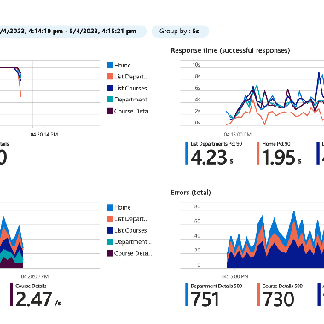
Why have Observable Applications?
Benefit of Hindsight
Simplify Complexity
Identify Trends
Notes:
Hindsight is 20:20
Issues with applications don’t always look like errors and users don’t always tell you when things go wrong. If you heard that a user was having issues with slow loading pages last Thursday, would you know where to look?
Observability can answer questions like- -
Is your performance trending?
Are you getting more errors?
Did the last release produce more issues?
When did you start seeing more load on your SQL Database?
Monitoring distributed systems can be challenging since microservices all have individual roles.

Slide 5
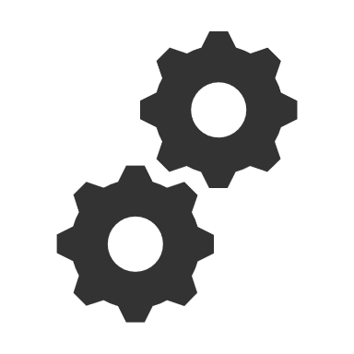

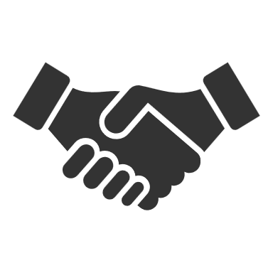

Introducing OpenTelemetry
A modern, open standard for observability of any application.
Trace end-to-end from frontend to backend in a distributed architecture.
Language SDKs for C++, C#, Go, Java, JavaScript, Python, Rust and more
An ecosystem of libraries for instrumentation and exporting to dashboards and SIEMs
Governed by the Cloud Native Computing Foundation (CNCF)
A standard protocol (OTLP) for communication between the data collector and the software
Notes:
Supercedes a number of technologies, including Prometheus, OpenCensus, TraceContext, OpenMetrics,

Slide 6
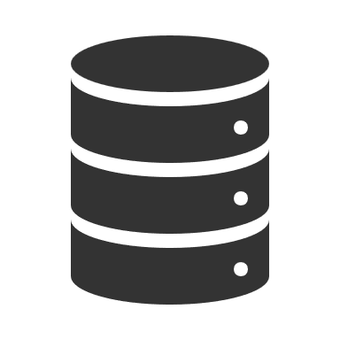

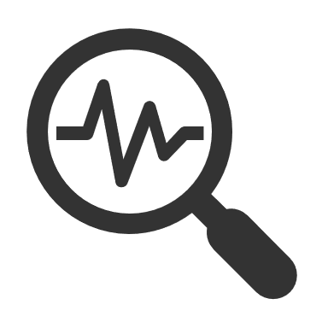
OpenTelemetry Architecture
Instrumentation
Collector
Exporter
Traces
Long term storage
Search
Automated Instrumentation
Client Instrumentation Libraries
Custom Instrumentation using the SDK
A service proxy of all instrumented data.
Telemetry Data
Metrics
Logs
Your Application
User Interface

Slide 7
Observability Concepts
Traces
Metrics
Logs
Trace units of work are called spans
Spans can have attributes
Spans are created by instrumentation libraries or manually via the SDK
Spans are nested
Spans have kinds
Metrics are measurements captured at runtime
Metrics are created by meters
Meters are defined in instrumentation libraries or manually via the SDK
Meters can be aggregate or live
Logs are a timestamped text record
Logs can be structured (with data) or unstructured (just text)
Log exporters can plug into existing logging infrastructure

Slide 8

AI SDK Support for OpenTelemetry
Traces
Metrics
Logs
Azure OpenAI SDK
Client (.NET)
*
Azure SDK (Python, JavaScript, .NET)
Semantic Kernel (.NET)

Slide 9
3rd Party Support for OpenTelemetry
* requires additional code
Traces
Metrics
Logs
LangChain
Elastic [1]
Redis [2]
LlamaIndex [3]

Slide 10
Demo

Slide 11
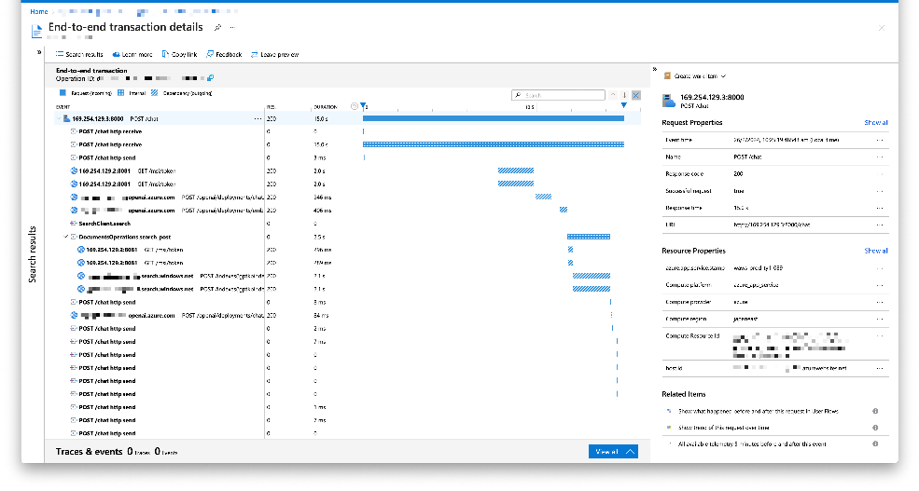
OpenTelemetry Support in Azure Monitor
Built-in UI
Support for OpenTelemetry via Azure Monitor Exporter
Delivered as-a-service in Microsoft Azure
Ideal for production workloads

Slide 12
Demo

Slide 13
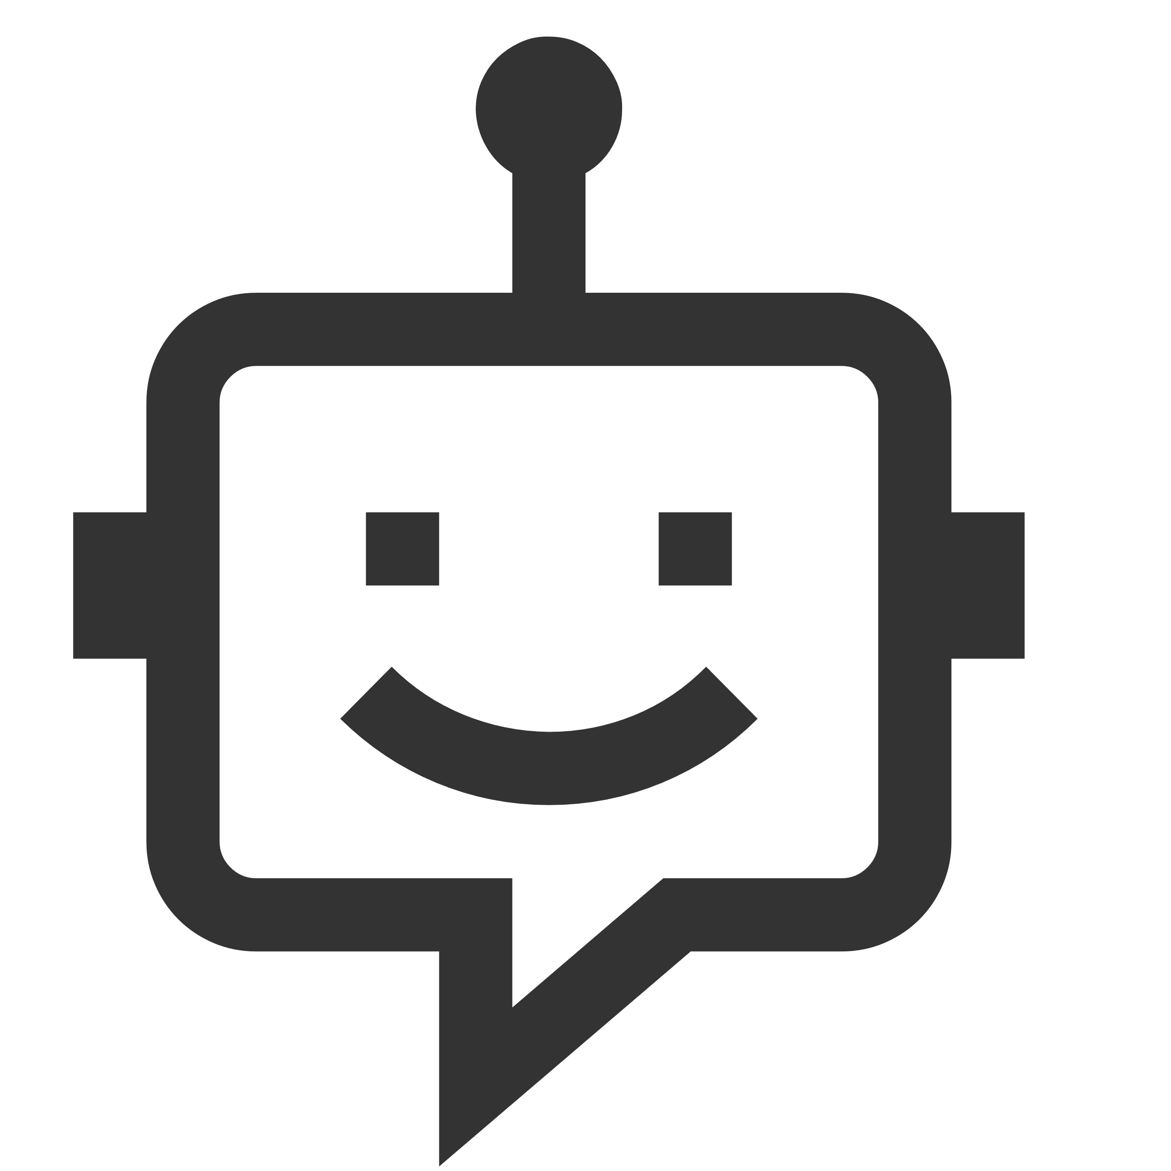

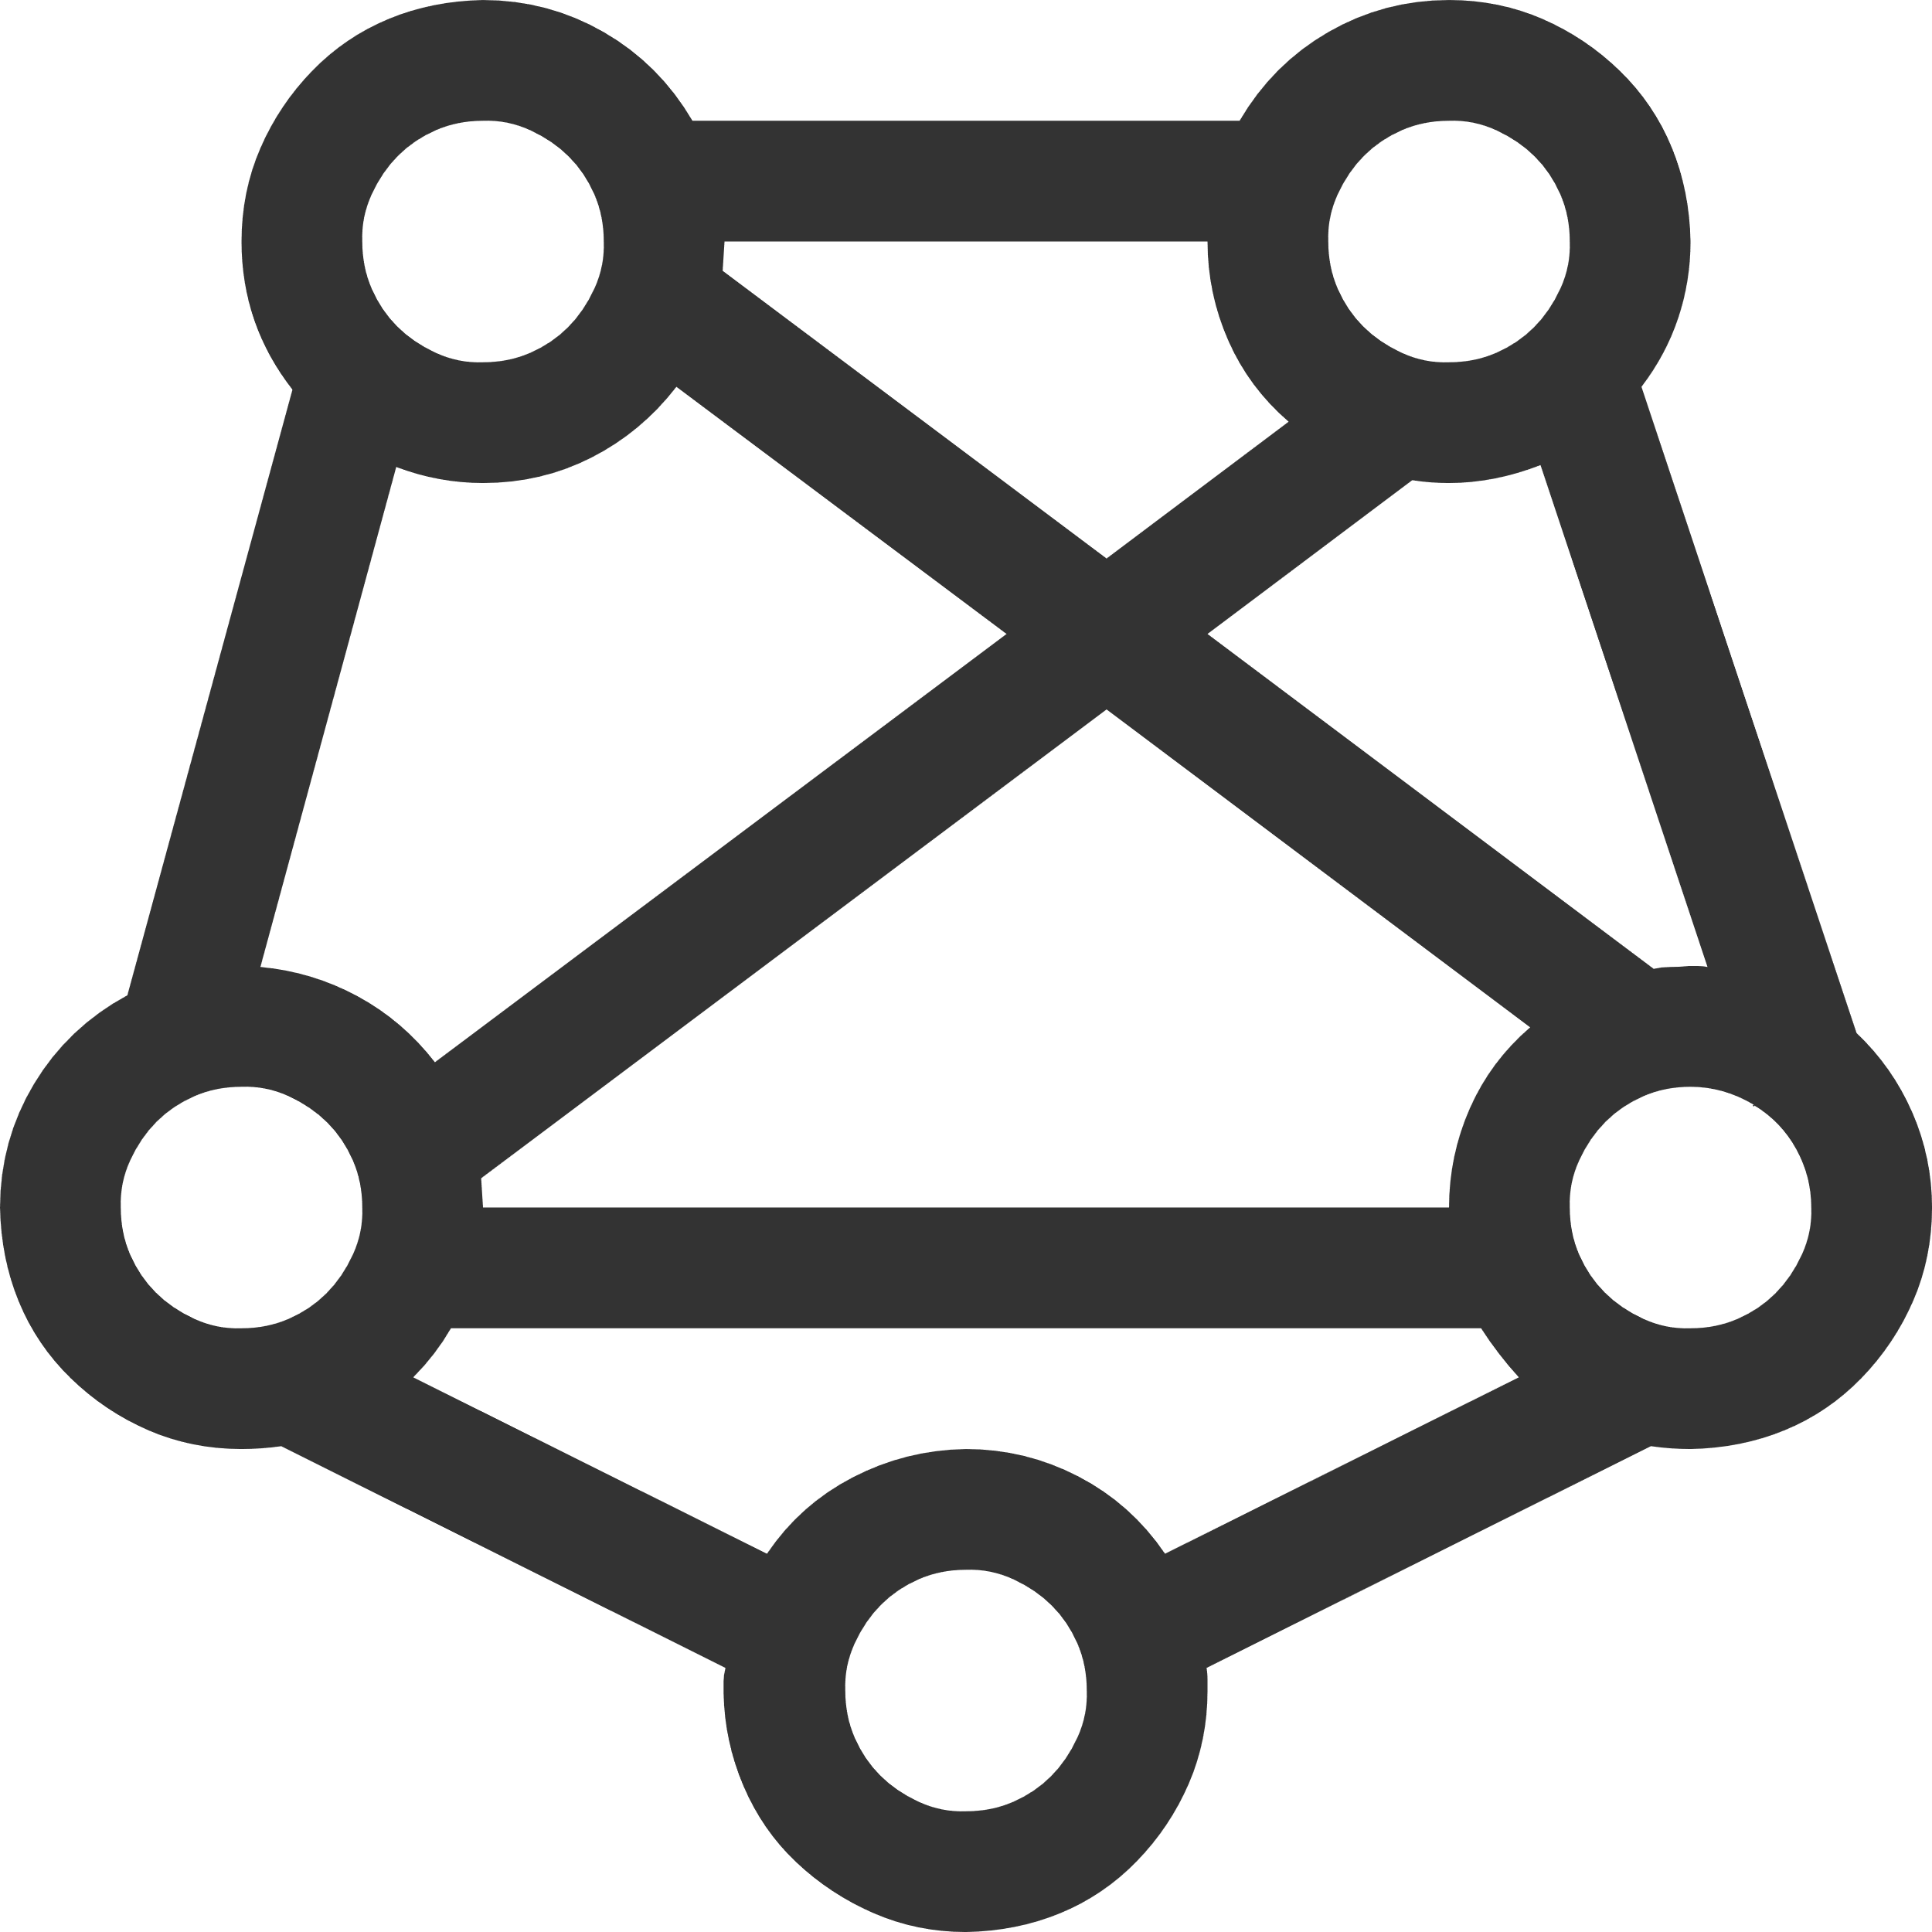
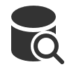
RAG – Retrieval Augmented Generation
Yes, your company perks cover underwater activities such as scuba diving lessons ¹
Do my company perks cover underwater activities?
PerksPlus.pdf#page=2: Some of the lessons covered under PerksPlus include: · Skiing and snowboarding lessons · Scuba diving lessons · Surfing lessons · Horseback riding lessons These lessons provide employees with the opportunity to try new things, challenge themselves, and improve their physical skills.….
User
Question
Document Search
Large Language Model
Notes:
RAG has 3 steps--
Get the question
Do a search
Add the response to the search to the user question and send it to the LLM
Retrieval isn’t always about search.
Now, let's talk about building our own Copilots. In that case, you'll build your own Copilot code with orchestration either built on your own code or maybe one of the popular open-source frameworks.
Then you'll need a retrieval system that can capture data from whatever it is that you store it. Maybe in some database systems, maybe these are PDFs and Office documents in Blob Storage, or who knows?
This retrieval system is then what would allow you to retrieve the bits and pieces required to answer any particular question or interaction.
Then you'll use a language model like the Azure OpenAI GPT models to actually apply reasoning to that content and produce a response.

Slide 14
RAG components
Component | Examples | Observability
Frontend: The Web, Mobile or API interface for your application | Blazor (.NET) Flask, FastAPI (Python) React, Vue.JS (JavaScript) | Capture a user request as a span using a tracing instrumentation library. All major frameworks supported.
Retriever: A knowledge base that can efficiently retrieve sources that match a user query | Azure AI Search, Azure CosmosDB, PostgreSQL, Qdrant, Pinecone | Create traces for API calls Capture API parameters as span attributes Add metrics using custom code
LLM: A model that can answer questions based on the query based on the provided sources, and can include citations | GPT 3.5, GPT 4, Llama2
Glue: A way to chain the retriever to the LLM (optional) | Langchain, Llamaindex, Semantic Kernel | Chains and flows are emitted as traces

Slide 15
Example: OpenTelemetry with AI Applications
Traces
Metrics
Logs
Retrieval calls
API calls
Document and Search lookup calls
Authentication calls
Tokens used
Tokens remaining
Tokens used per query
Response times
User query
Safety violations
Response from LLM
Capture AI-specific attributes
Track token usage
Add trace ID to log entries

Slide 16
Demo

Slide 17
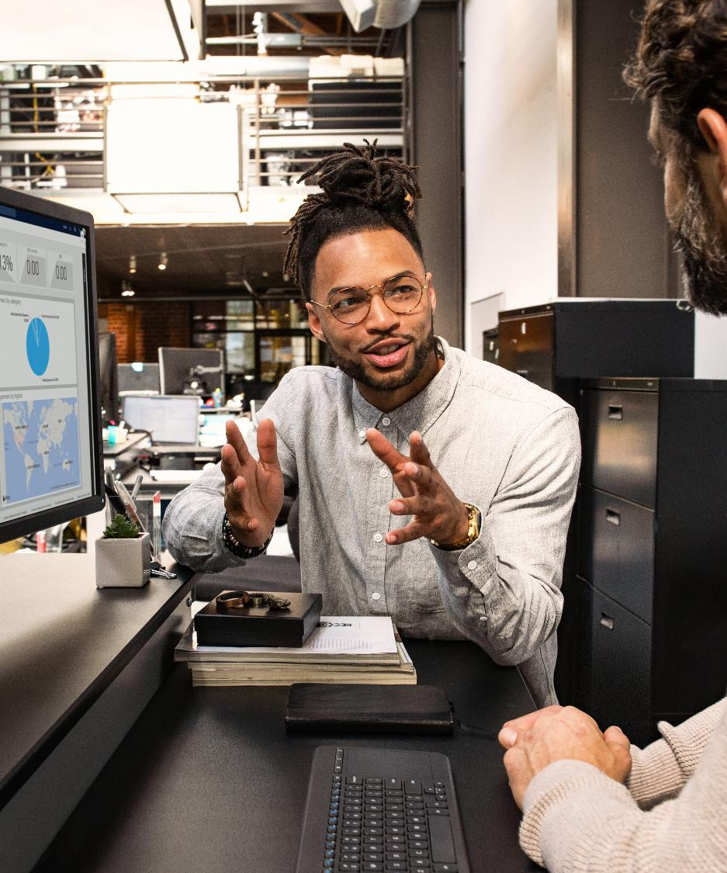
Recap
OpenTelemetry is a plugin solution
Using OpenTelemetry during development can help with debugging
Look for instrumentation libraries of your current technology stack

Slide 18
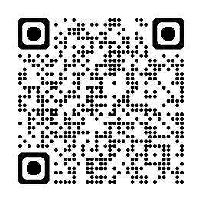
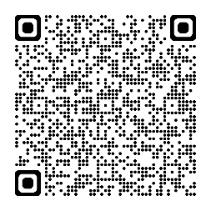
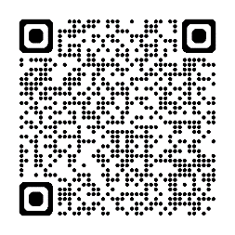
Resources
Azure AI Search sample project
Implement observability in a cloud-native .NET 8 application with OpenTelemetry
Unlock the Power of Telemetry in Semantic Kernel SDK

Slide 19
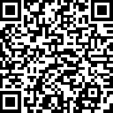
.NET Conf: Focus on AI
Learn more
aka.ms/dotnetFocusAI/Collection

